Slide 1
SMART HEALTH AND WELLNESS MONITORING SYSTEM
TEAM-2

Slide 2
INTRODUCTION
This is the smart health monitoring system designed that allows users to track and manage their health metrics in real-time.
The system will leverage wearable device data to monitor vital signs, physical activity, and wellness indicators, offering personalized health insights through visualizations and insights.
An admin panel will facilitate user account management and system performance oversight.

Slide 3
PROJECT OVERVIEW
ADMINISTRATOR FEATURES
REGISTRATION for the new user to access the application.
LOGIN for the customer to access the total features of the application.
ADMIN DASHBOARD to view the details of doctors availability for the user.
CUSTOMER FEATURES
HEALTH INSIGHTS to analyze health data to generate personalized insights.
WELLNESS TRACKING SYSTEM to implement features for setting and tracking wellness goals,monitoring and managing the expenses spent on the health i.e. food or fitness.
ADDITIONAL FEATURE
Additional Suggestions feature is introduced in order to give quick remedies to the given health symptoms.

Slide 4
TECH STACK
FRONTEND : HTML, CSS, Java Script.
BACKEND : Python.
FRAMEWORK : Django Framework.
DATABASE : MySQL.
LIBRARIES : Matplotlib, mysqlclient.
TOOLS : VS code.

Slide 5
MILESTONES
USER AUTHENTICATION - Implementing user registration, login, and logout features using Django REST Framework and configuring token-based authentication for API security.
HEALTH DATA COLLECTION - This is implemented using Gemini ai model to implement health data features in few modules.
HEALTH INSIGHTS AND RECOMMENDATIONS - Implementing features for setting and tracking wellness goals and analyzing health data to generate personalized insights and visualizes the data.
WELLNESS GOALS AND TRACKING - Configuring and managing expenses in one’s health diet and maintenance.
ADMIN DASHBOARD - An admin panel is developed using Django Admin for user management.

Slide 6
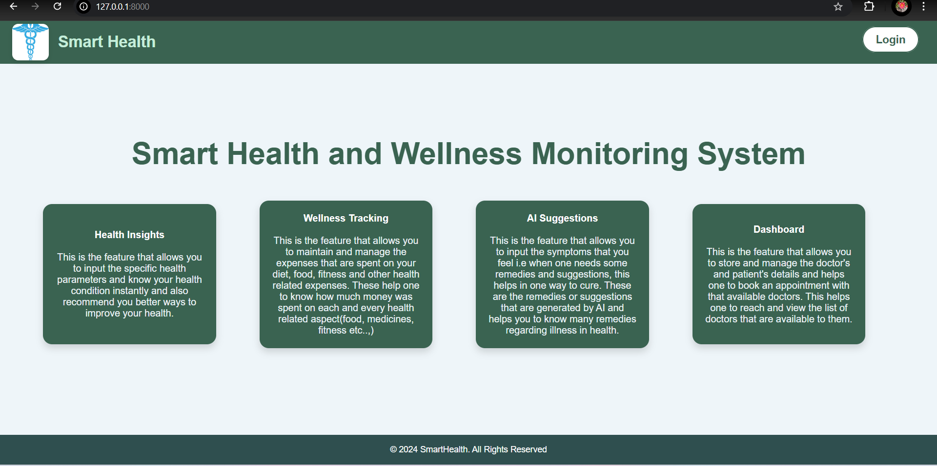
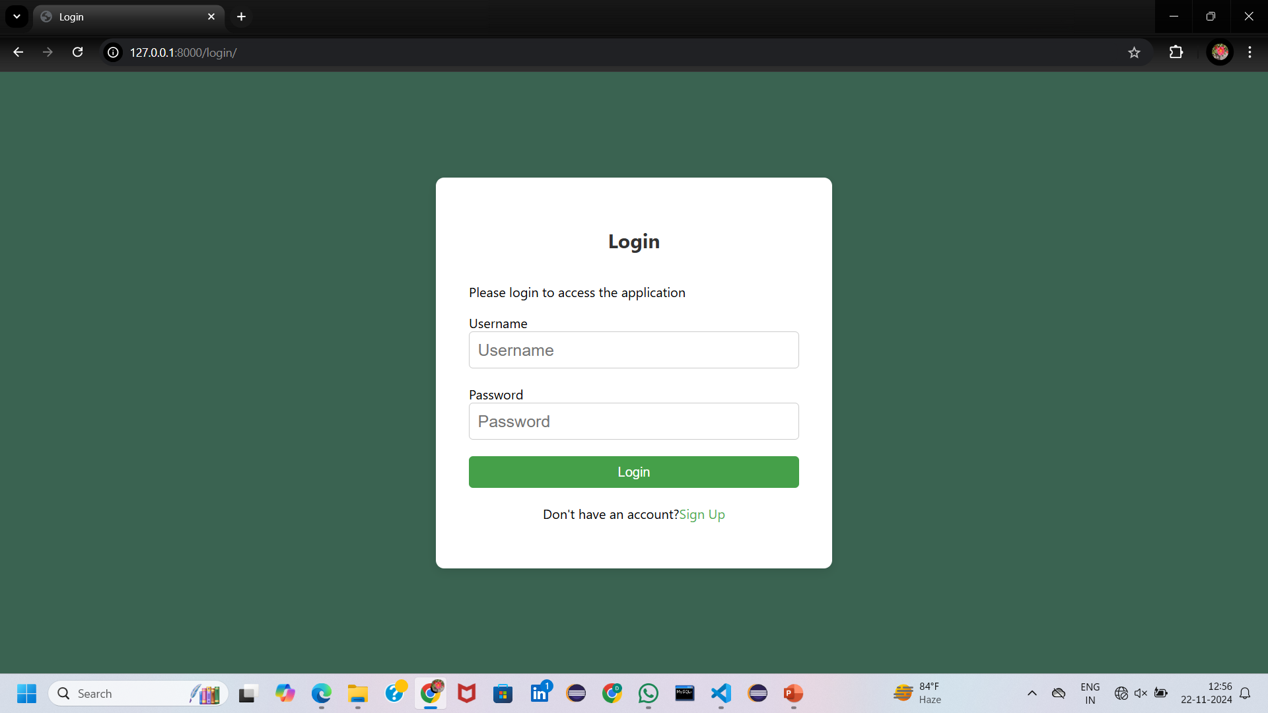
HOME PAGE BEFORE LOGIN
This is the simple home page before logging in.
LOGIN PAGE
Login page designed for user authentication.

Slide 7
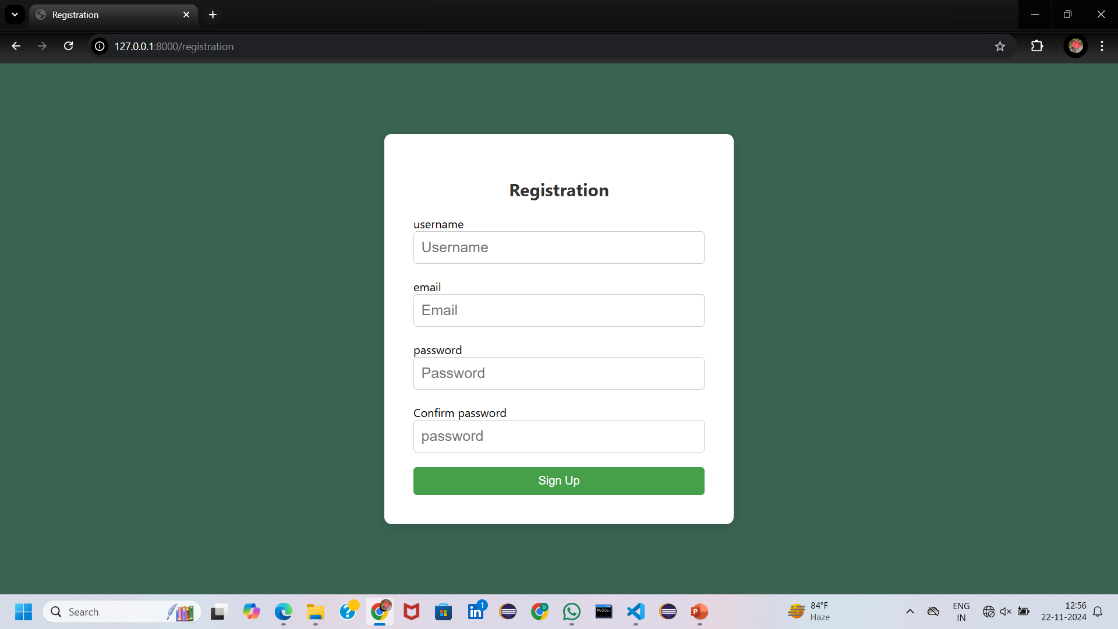
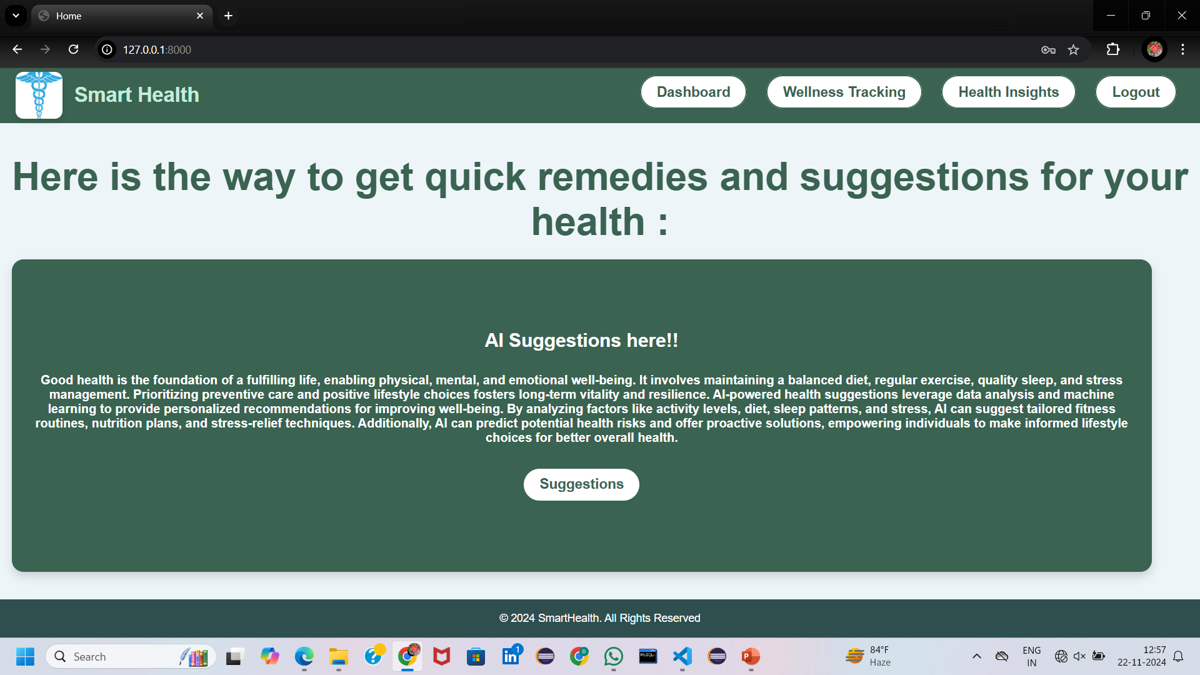
REGISTER PAGE
Registration page designed for the new user to access the application.
HOME PAGE AFTER LOGIN
Once the user logged in successfully, will be redirected to the main home page.

Slide 8
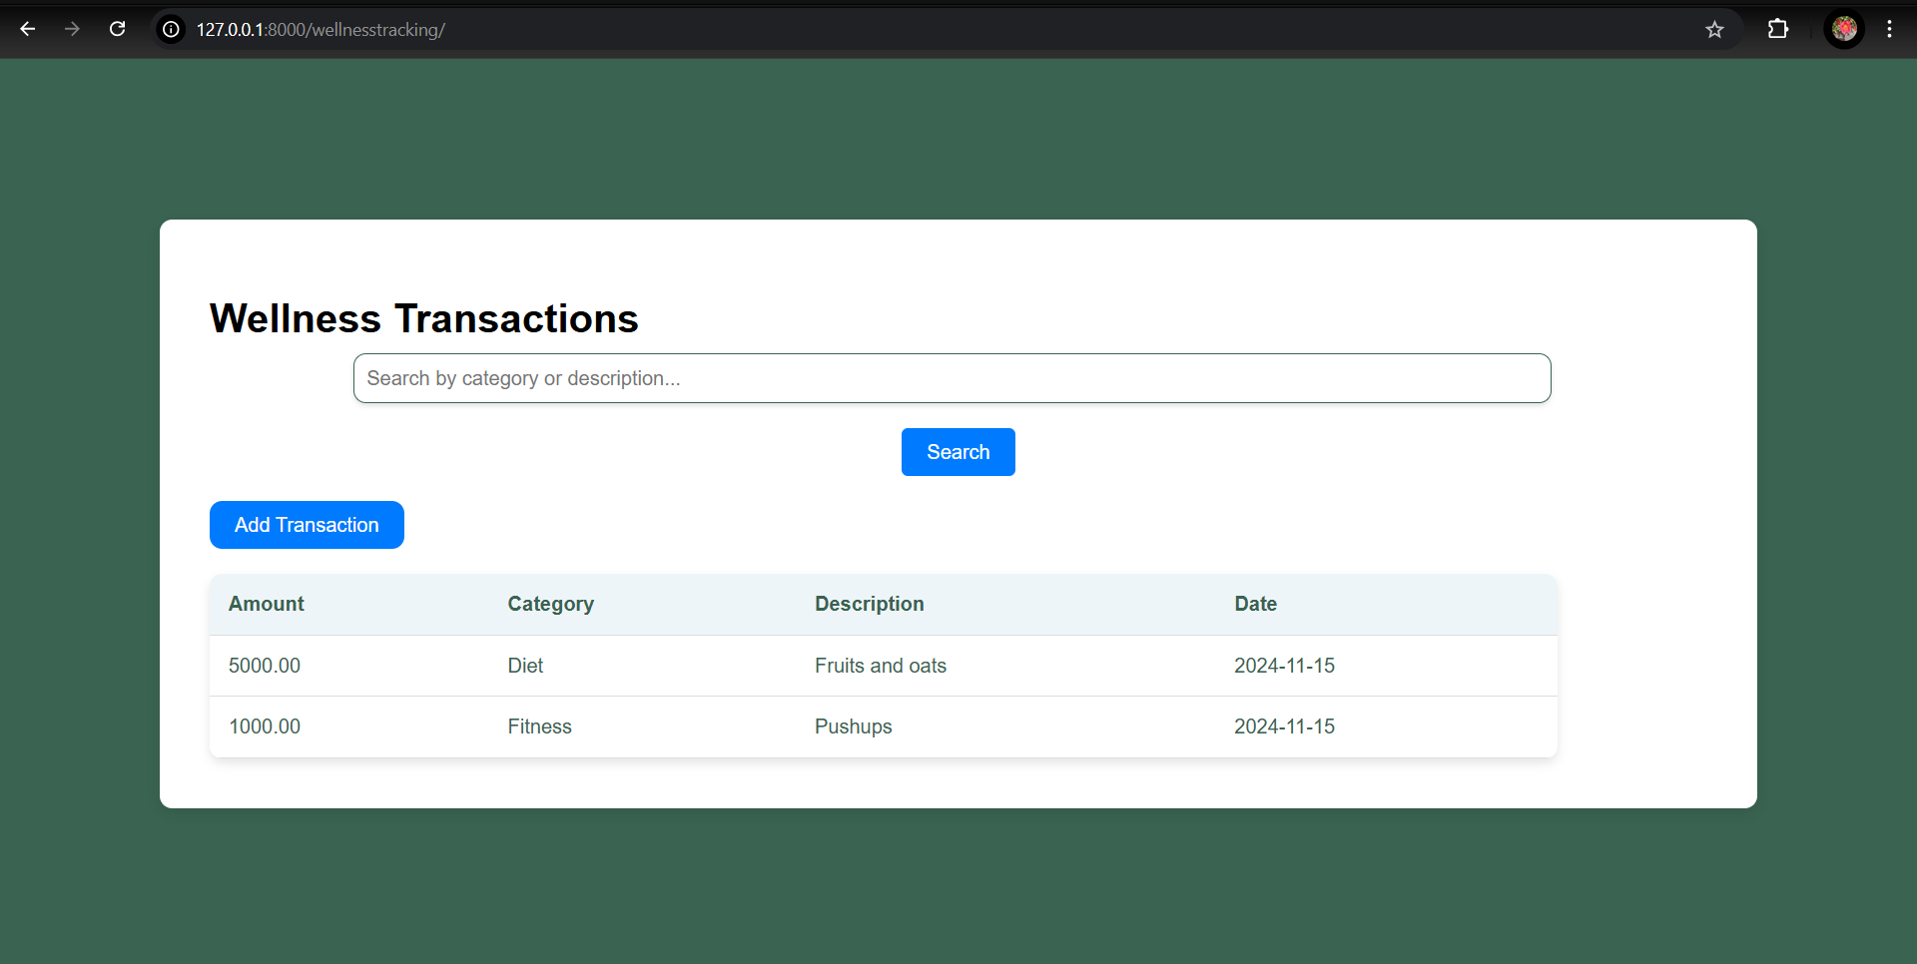
WELLNESS TRACKING SYSTEM
Wellness tracking system designed for noting the expenses about the health and diet and managing them accordingly.

Slide 9
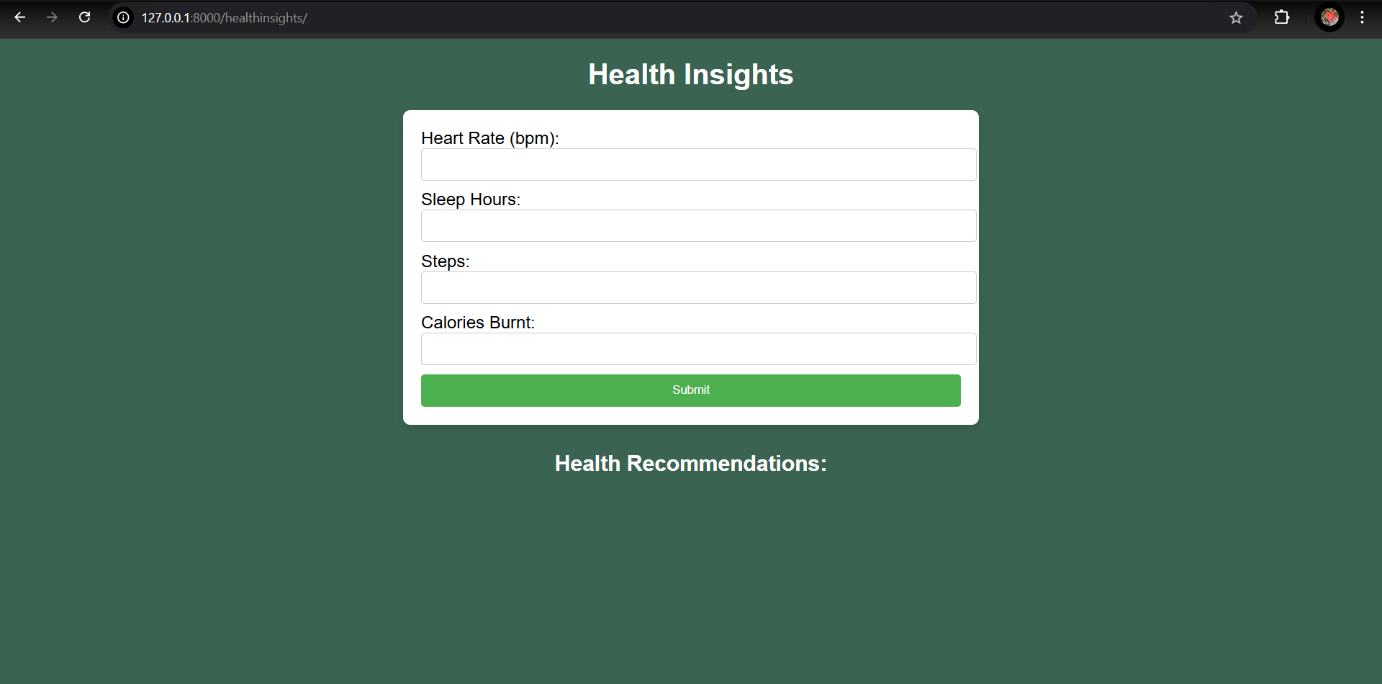
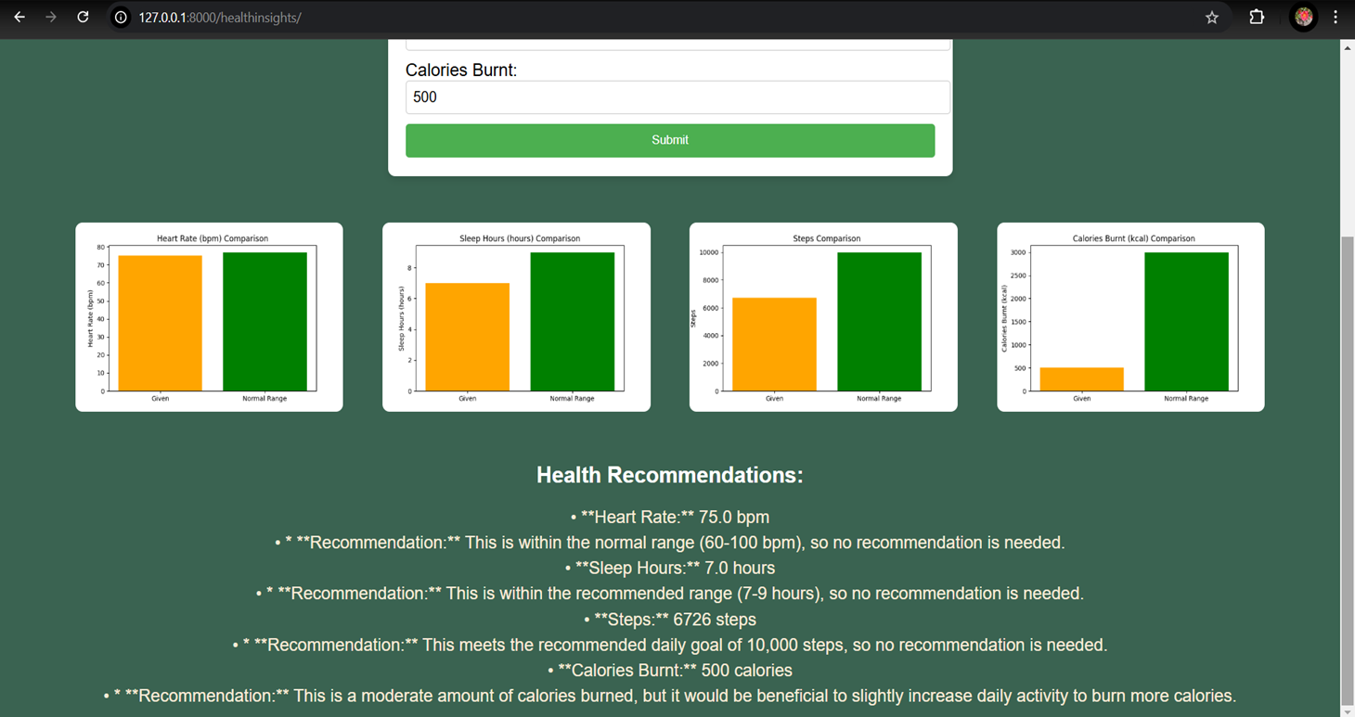
HEALTH INSIGHTS
This is the application designed to take few metrics regarding health such as heart rate, sleep hours, steps, calories burnt and give the visualization with the normal range and analyse the data.
This is the result of given metrics and suggested recommendations generated using AI.

Slide 10
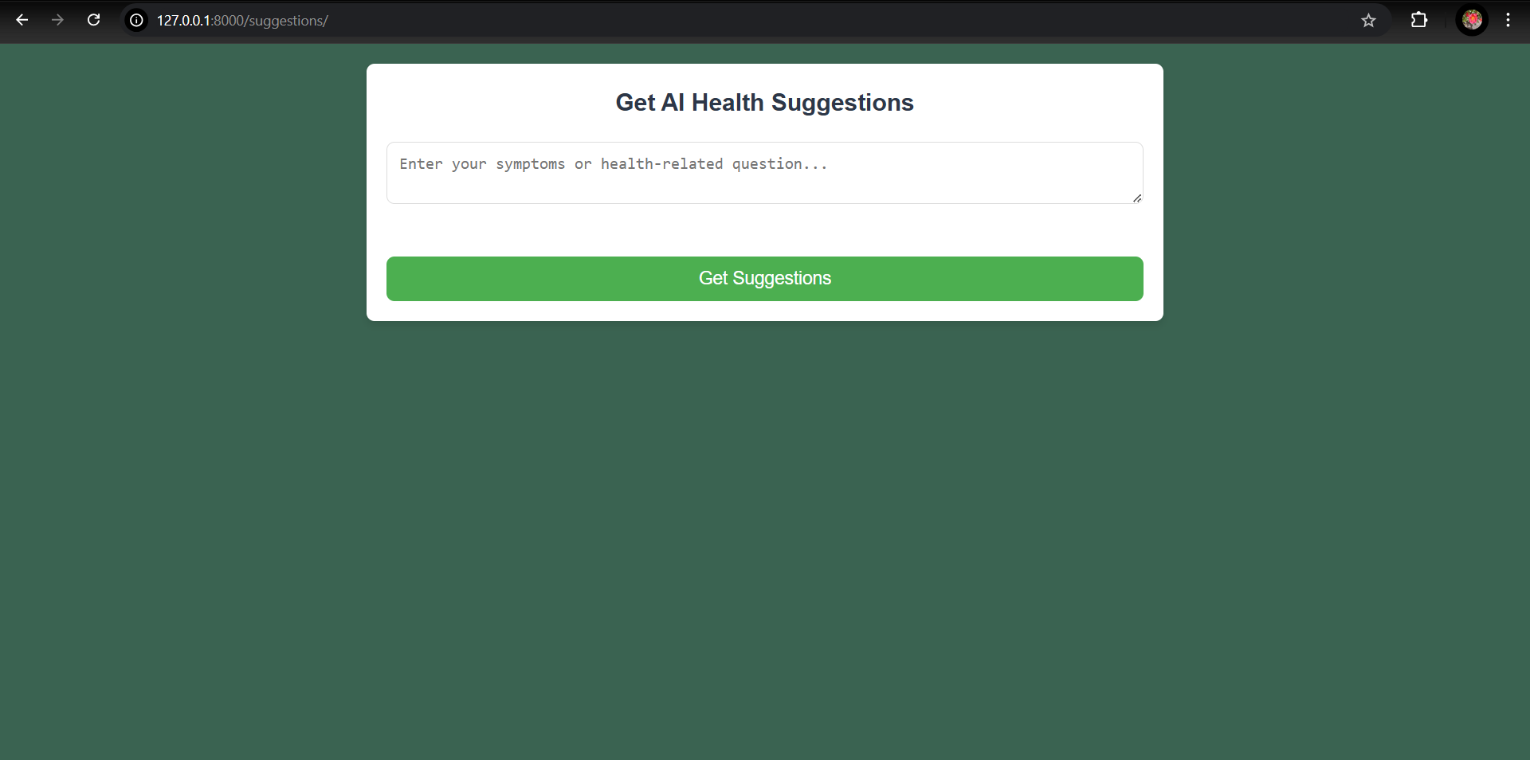
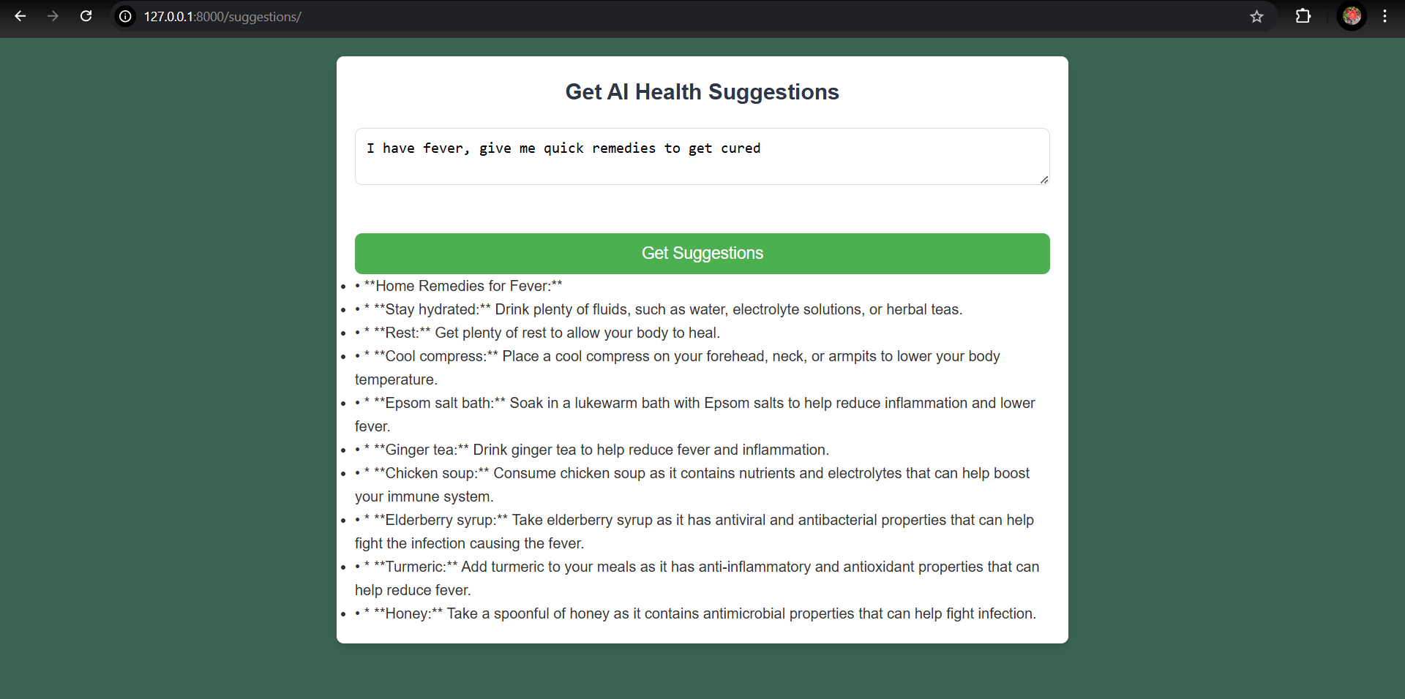
AI SUGGESTIONS
This is the page developed using Gemini ai API integration.
This gives the suggestions and remedies when the symptoms are given as prompt.

Slide 11
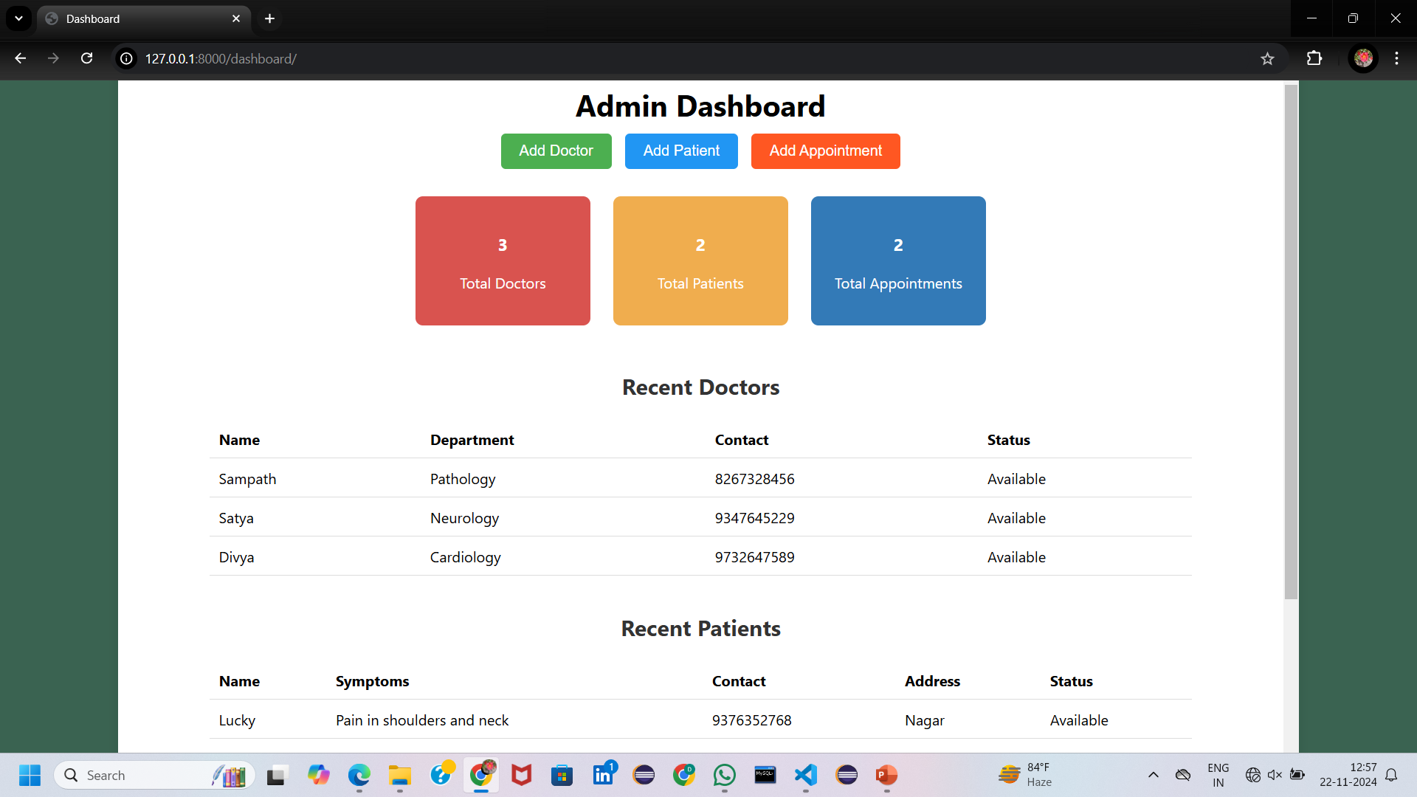
DASHBOARD
This is used to manage the data of number of doctors, patients and appointments.

Slide 12
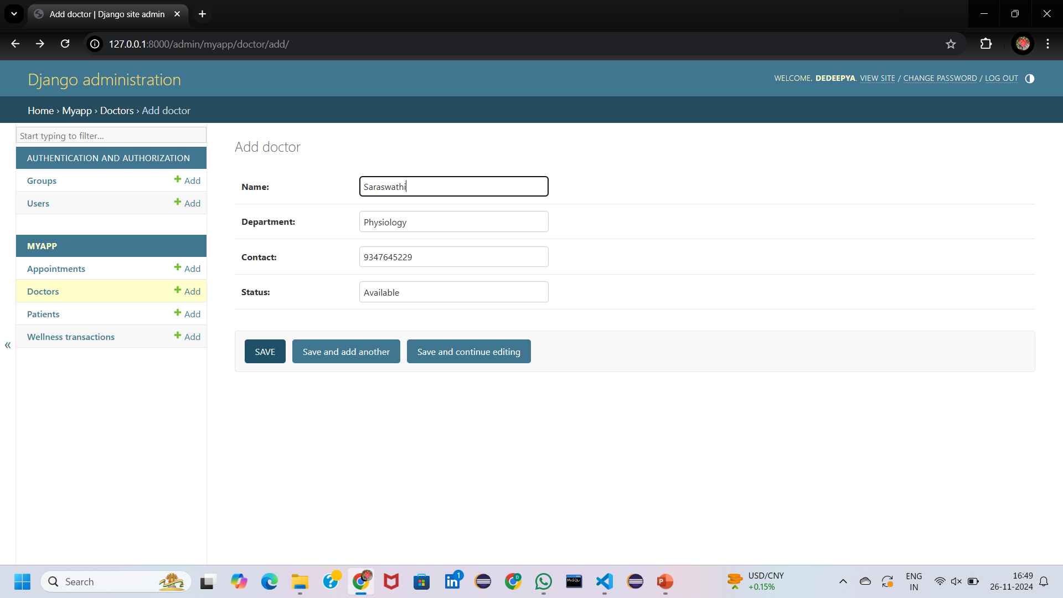
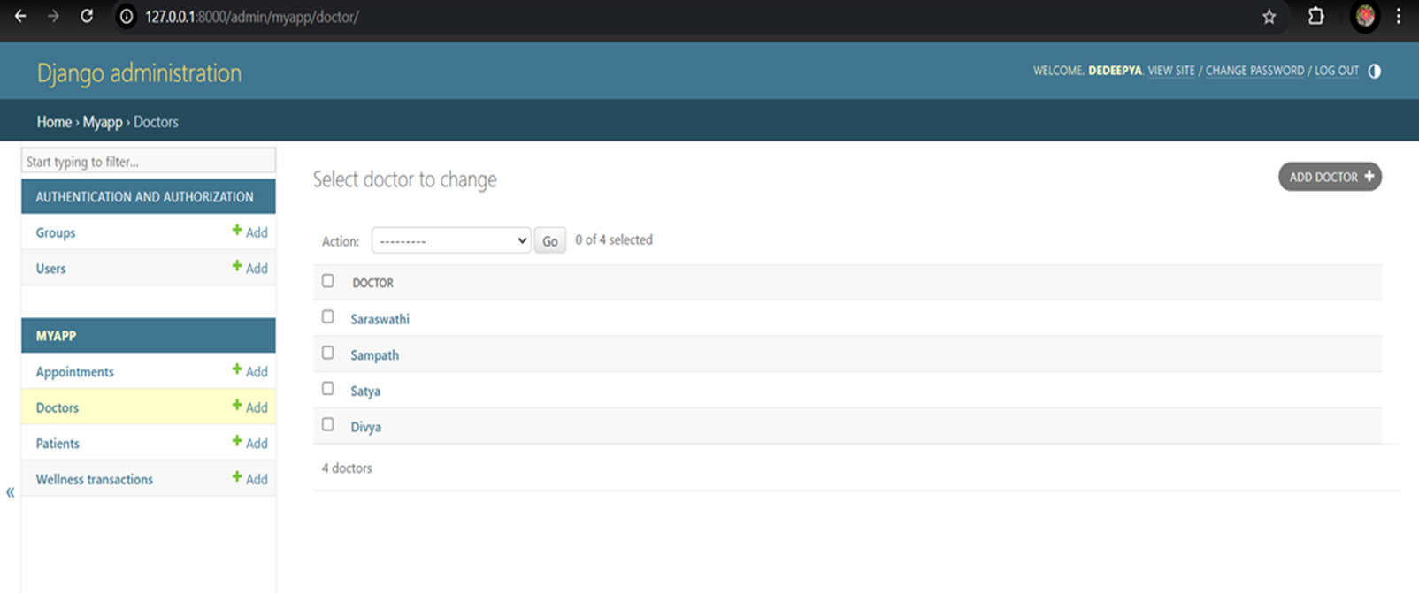
DJANGO ADMIN – DOCTORS DATA
Entering doctor’s data with name, department they belongs to and saving it in the Django admin panel.
List of doctors getting displayed after saving the data.

Slide 13
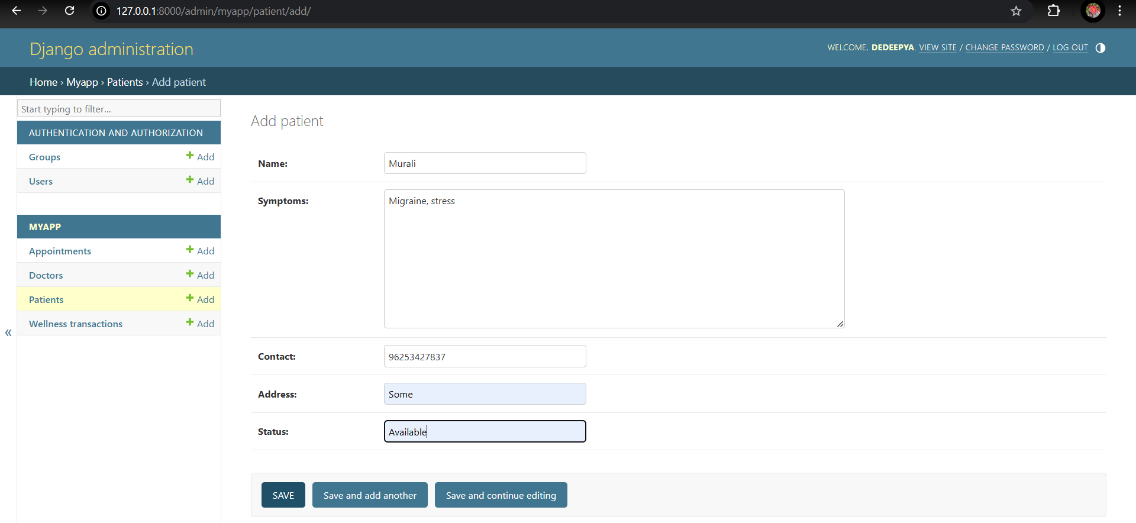
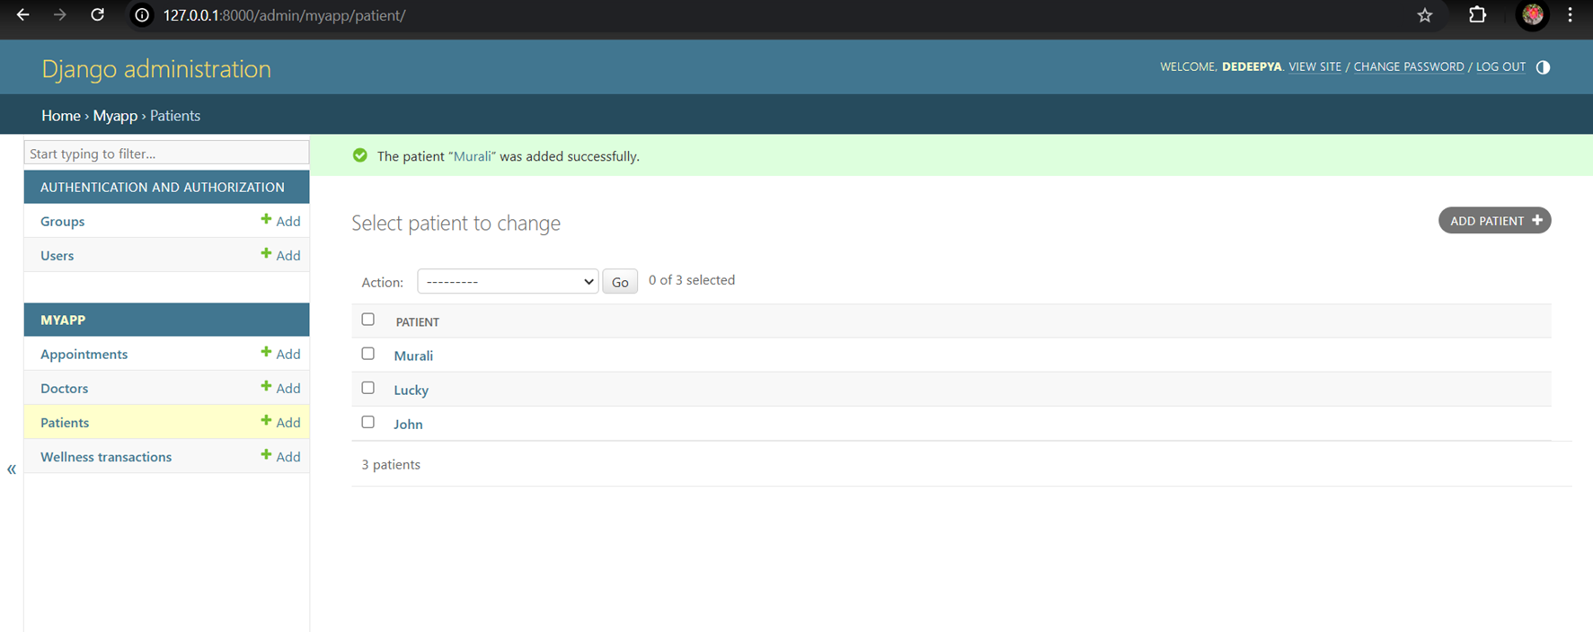
DJANGO ADMIN – PATIENTS DATA
Entering patient’s data with name, symptoms and other details and saving it in the Django admin panel.
List of patients getting displayed after saving the data.

Slide 14
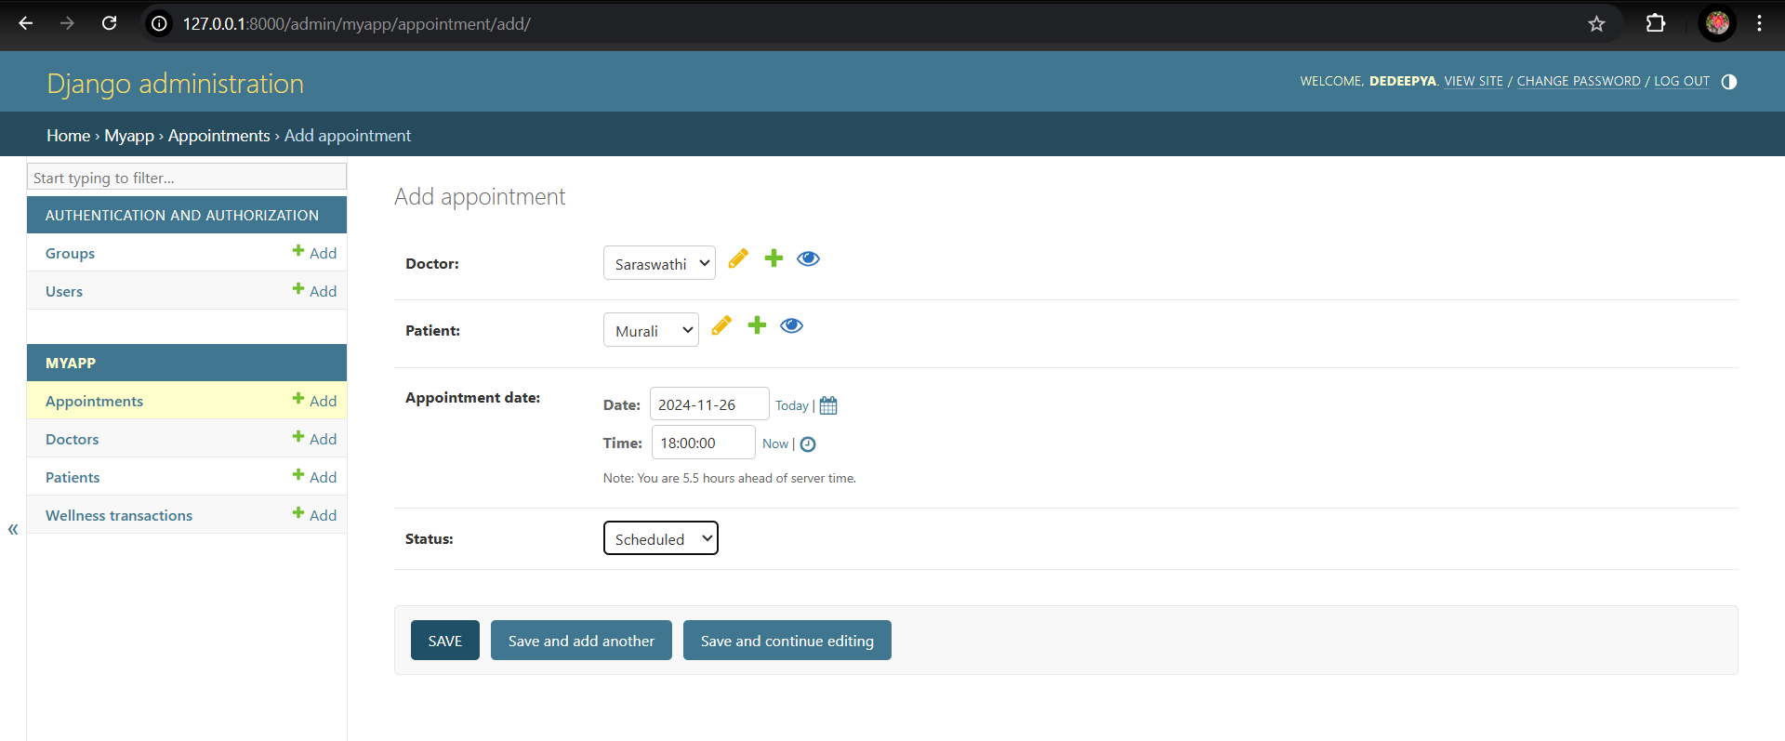
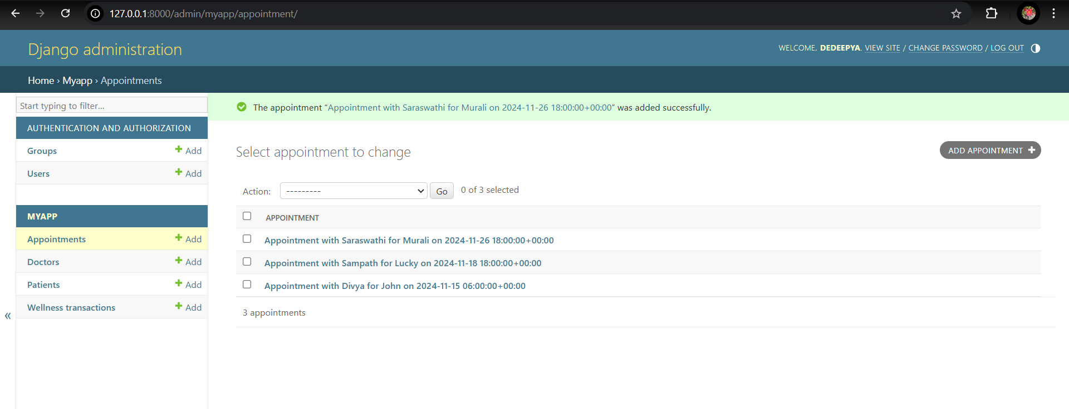
DJANGO ADMIN – APPOINTMENTS DATA
Entering doctor’s and patient’s details to book an appointment and saving it in the Django admin panel.
List of appointments scheduled are displayed after saving data.

Slide 15
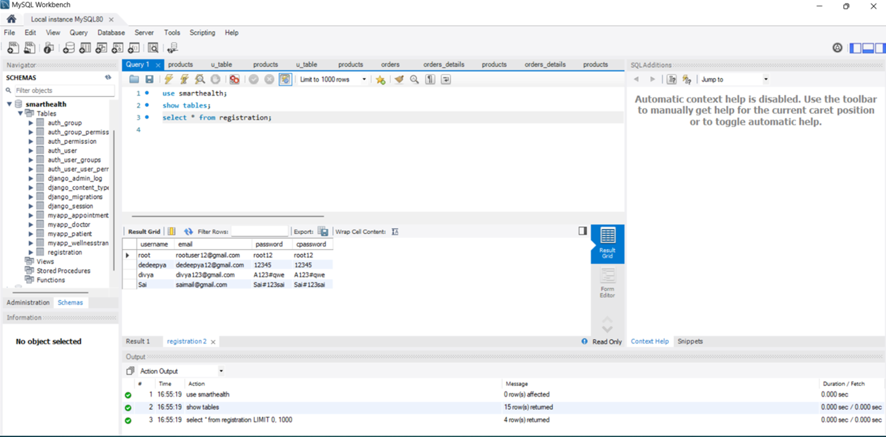
DATABASE OF THE PROJECT
MySQL workbench used for maintaining the database regarding the project.

Slide 16
CONCLUSION
Smart health monitoring system is very helpful in knowing the health insights of the user easily.
The more reliable features of this system enables the user to track his/her wellness goals.
This enables user to visualise and compare user’s health metrics with the good health metrics and get recommendations if needed to improve health accordingly.
There is a scope of adding more features in the application like giving the information about the available hospitals around them etc.

Slide 17
TEAM MEMBERS
DEDEEPYA NAKERAKANTI
ARGHYA CHATTARAJ
NIKHILA KRISHNA PRIYA PANTAM
SWAYAM DESAI
JANANI

Slide 18
THANK YOU

